Slide 1
CS 7643: Deep Learning
Topics:
Generative Models (PixelRNNs, VAEs, GANs)
Key Ideas
AE, Reparameterization, Variational Inference
Dhruv Batra
Georgia Tech

Slide 2
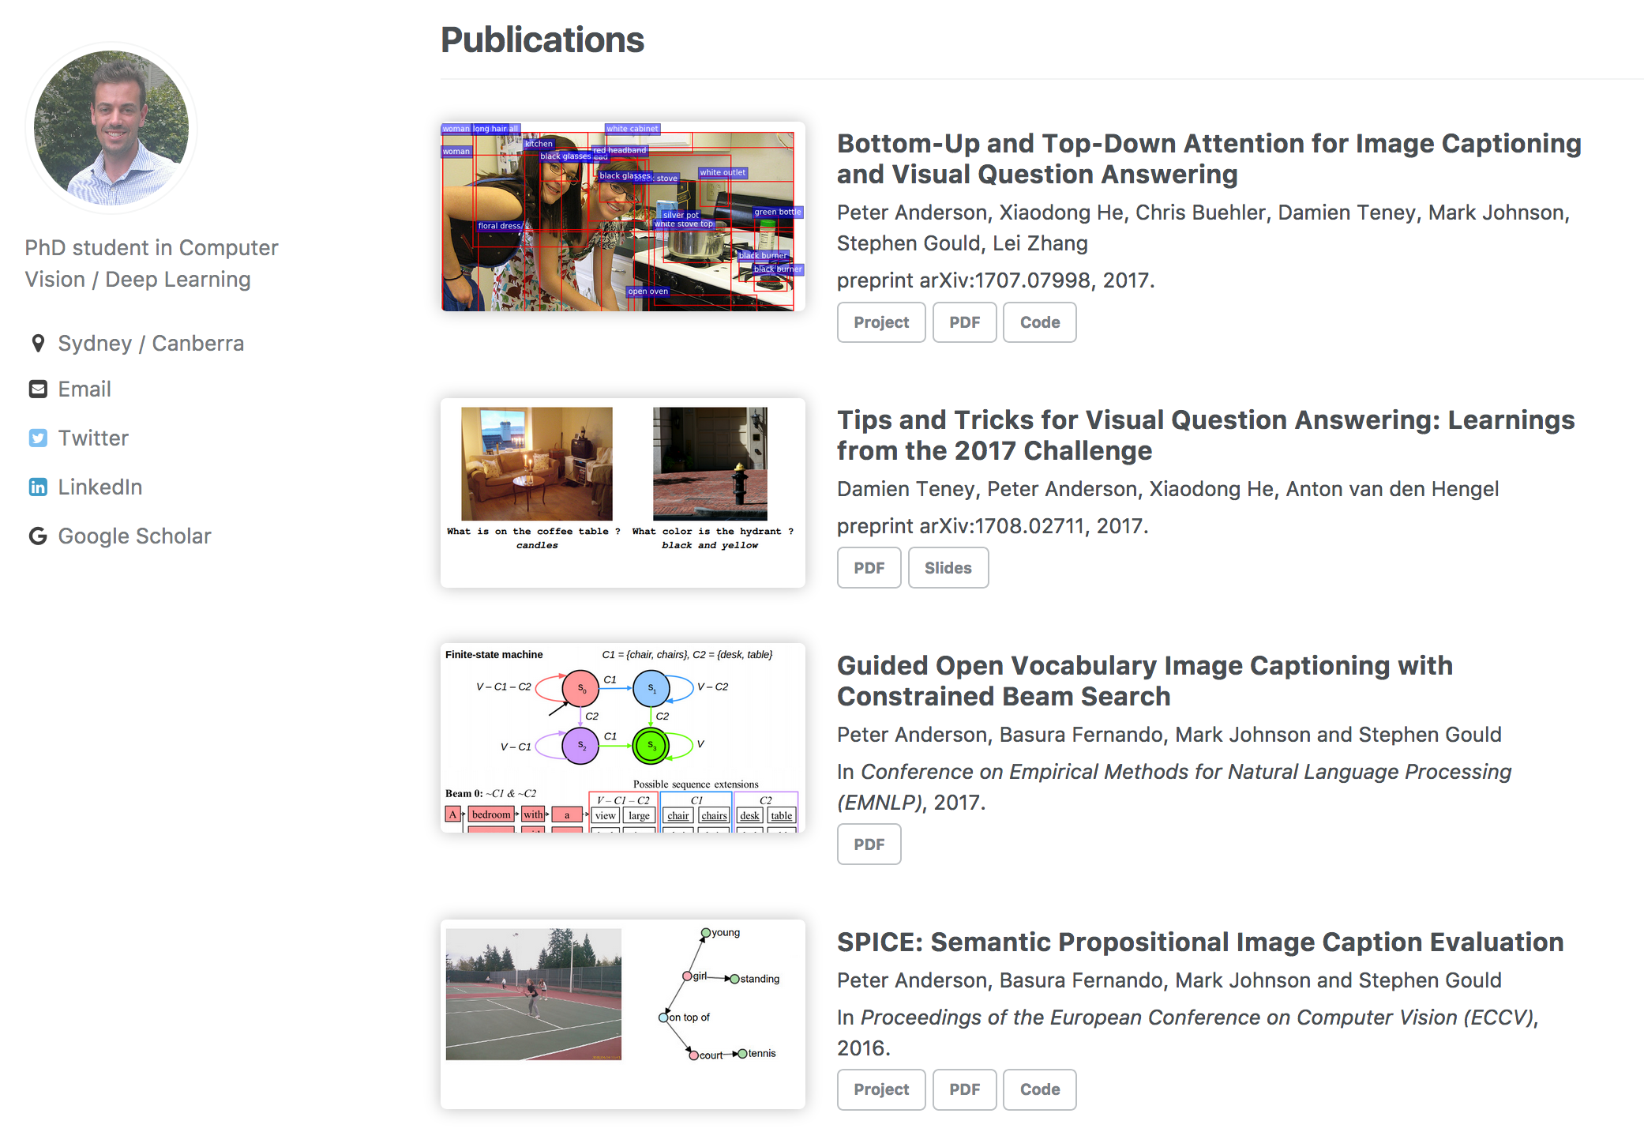
Invited Talk
Peter Anderson, ANU
Visual Understanding in Natural Language
Co-located as ML@GT Seminar, Nov 27 11am, Nano 1117

Slide 3
Administrativia
Poster Presentation:
Wed 11/29, 2-4pm
In two sessions
Klaus Auditorium
Less text, more pictures.
Best Project Award!

Slide 4
Overview
Unsupervised Learning
Generative Models
PixelRNN and PixelCNN
Variational Autoencoders (VAE)
Generative Adversarial Networks (GAN)
Slide Credit: Fei-Fei Li, Justin Johnson, Serena Yeung, CS 231n
Notes:
Unsupervised learning problem
Generative models, type of unsupervised learning
3 types of generative models
PixelRNN and PixelCNN, type of fully visible belief networks

Slide 5
Supervised vs Unsupervised Learning
Supervised Learning
Data: (x, y)
x is data, y is label
Goal: Learn a function to map x → y
Examples: Classification, regression, object detection, semantic segmentation, image captioning, etc.
Slide Credit: Fei-Fei Li, Justin Johnson, Serena Yeung, CS 231n
Notes:
In this class so far, have talked about a lot of sup. Learning problems
Data x, y is a label, and label can take many different forms

Slide 6
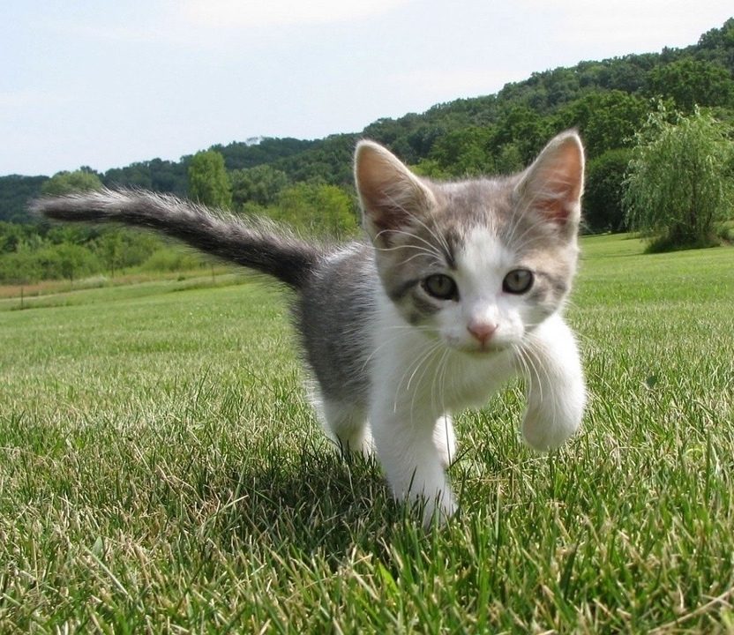
Supervised vs Unsupervised Learning
Supervised Learning
Data: (x, y)
x is data, y is label
Goal: Learn a function to map x → y
Examples: Classification, regression, object detection, semantic segmentation, image captioning, etc.
Cat
Classification
This image is CC0 public domain
Slide Credit: Fei-Fei Li, Justin Johnson, Serena Yeung, CS 231n
Notes:
Label is category

Slide 7
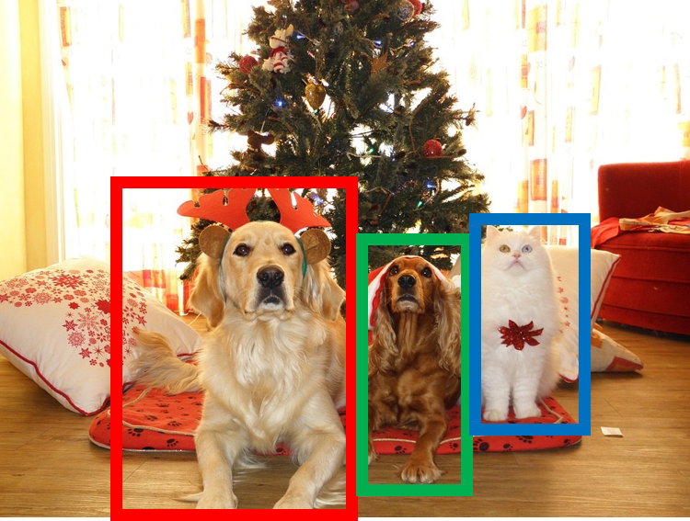
Supervised vs Unsupervised Learning
Supervised Learning
Data: (x, y)
x is data, y is label
Goal: Learn a function to map x → y
Examples: Classification, regression, object detection, semantic segmentation, image captioning, etc.
DOG, DOG, CAT
Object Detection
This image is CC0 public domain
Slide Credit: Fei-Fei Li, Justin Johnson, Serena Yeung, CS 231n

Slide 8
Supervised vs Unsupervised Learning
Supervised Learning
Data: (x, y)
x is data, y is label
Goal: Learn a function to map x → y
Examples: Classification, regression, object detection, semantic segmentation, image captioning, etc.
GRASS, CAT, TREE, SKY
Semantic Segmentation
Slide Credit: Fei-Fei Li, Justin Johnson, Serena Yeung, CS 231n

Slide 9

Supervised vs Unsupervised Learning
Supervised Learning
Data: (x, y)
x is data, y is label
Goal: Learn a function to map x → y
Examples: Classification, regression, object detection, semantic segmentation, image captioning, etc.
A cat sitting on a suitcase on the floor
Image captioning
Caption generated using neuraltalk2
Image is CC0 Public domain.
Slide Credit: Fei-Fei Li, Justin Johnson, Serena Yeung, CS 231n

Slide 10
Supervised vs Unsupervised Learning
Unsupervised Learning
Data: x
Just data, no labels!
Goal: Learn some underlying hidden structure of the data
Examples: Clustering, dimensionality reduction, feature learning, density estimation, etc.
Slide Credit: Fei-Fei Li, Justin Johnson, Serena Yeung, CS 231n
Notes:
Unsupervised learning is a type of learning where we have unlabeled training data, and we want to learn some underlying hidden structure of the data

Slide 11
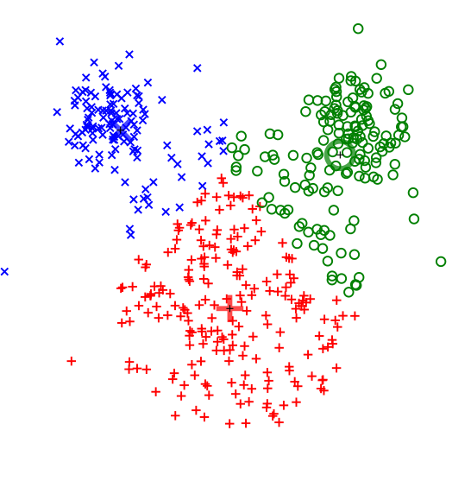
Supervised vs Unsupervised Learning
Unsupervised Learning
Data: x
Just data, no labels!
Goal: Learn some underlying hidden structure of the data
Examples: Clustering, dimensionality reduction, feature learning, density estimation, etc.
K-means clustering
This image is CC0 public domain
Slide Credit: Fei-Fei Li, Justin Johnson, Serena Yeung, CS 231n
Notes:
Clustering - find groups within the data that are similar through some metric

Slide 12

Supervised vs Unsupervised Learning
Unsupervised Learning
Data: x
Just data, no labels!
Goal: Learn some underlying hidden structure of the data
Examples: Clustering, dimensionality reduction, feature learning, density estimation, etc.
3-d
2-d
Principal Component Analysis
(Dimensionality reduction)
This image from Matthias Scholz is CC0 public domain
Slide Credit: Fei-Fei Li, Justin Johnson, Serena Yeung, CS 231n
Notes:
Find axes along which the data has most variation, this is part of the underlying structure of the data
Use this to reduce the dimensionality of the data such that the data has significant variation among each remaining dimension
Here is an example, take 3d data, finding 2 axes of variatiation and reducing dimensionality to 2d

Slide 13
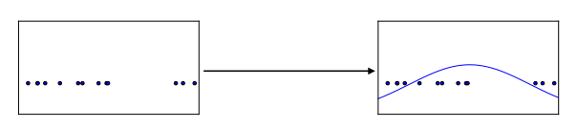
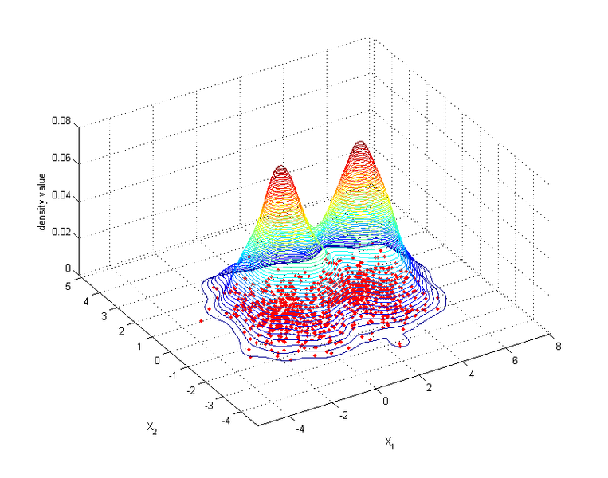
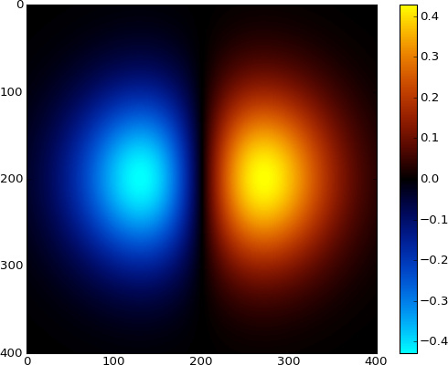
Supervised vs Unsupervised Learning
Unsupervised Learning
Data: x
Just data, no labels!
Goal: Learn some underlying hidden structure of the data
Examples: Clustering, dimensionality reduction, feature learning, density estimation, etc.
Figure copyright Ian Goodfellow, 2016. Reproduced with permission.
1-d density estimation
2-d density estimation
2-d density images left and right are CC0 public domain
Slide Credit: Fei-Fei Li, Justin Johnson, Serena Yeung, CS 231n
Notes:
Finally, another example is density estimation, which is estimating the underlying distribution of your data.
For example, in top example, have points in 1-d, and we can try to fit a gaussian to the density
In the bottom example, have 2d data. Again trying to estimate the density, and we model the density to be higher where more points are concentrated

Slide 14
Supervised vs Unsupervised Learning
Supervised Learning
Data: (x, y)
x is data, y is label
Goal: Learn a function to map x -> y
Examples: Classification, regression, object detection, semantic segmentation, image captioning, etc.
Unsupervised Learning
Data: x
Just data, no labels!
Goal: Learn some underlying hidden structure of the data
Examples: Clustering, dimensionality reduction, feature learning, density estimation, etc.
Slide Credit: Fei-Fei Li, Justin Johnson, Serena Yeung, CS 231n
Notes:
To summarize differences, sup uses labeled data to learn a function mapping from x to y
Unsup uses no labels, tries to learn some underlying hidden structure of the data, whether grouping, axes of variation, underlying density

Slide 15
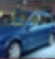
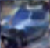
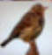
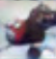
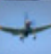
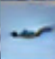
Generative Models
Given training data, generate new samples from same distribution
Training data ~ p_{data}(x)
Generated samples ~ p_{model}(x)
Want to learn p_{model}(x) similar to p_{data}(x)
Slide Credit: Fei-Fei Li, Justin Johnson, Serena Yeung, CS 231n
Notes:
Today we’ll focus on generative models, a class of models for unsupervised learning that given training data, tries to generate new samples from the same distribution

Slide 16
Generative Models
Given training data, generate new samples from same distribution
Training data ~ p_{data}(x)
Generated samples ~ p_{model}(x)
Want to learn p_{model}(x) similar to p_{data}(x)
Addresses density estimation, a core problem in unsupervised learning
Several flavors:
Explicit density estimation: explicitly define and solve for p_{model}(x)
Implicit density estimation: learn model that can sample from p_{model}(x) w/o explicitly defining it
Slide Credit: Fei-Fei Li, Justin Johnson, Serena Yeung, CS 231n
Notes:
Addresses the problem of density estimation, which is a core problem in unsup learning

Slide 17
Taxonomy of Generative Models
Direct
GAN
Generative models
Explicit density
Implicit density
Tractable density
Approximate density
Markov Chain
Fully Visible Belief Nets
NADE
MADE
PixelRNN/CNN
Change of variables models (nonlinear ICA)
GSN
Variational
Markov Chain
Variational Autoencoder
Boltzmann Machine
Figure copyright and adapted from Ian Goodfellow, Tutorial on Generative Adversarial Networks, 2017.
Slide Credit: Fei-Fei Li, Justin Johnson, Serena Yeung, CS 231n
Notes:
If we look at types of generative models, can be organized into this taxonomy, where 2 major branches are, as mentioned earlier, explicit density models that explicitly define and solve for the underlying density function, and implicit density models that represent the underlying distribution implicitly through its samples

Slide 18
Taxonomy of Generative Models
Direct
Today: discuss 3 most popular types of generative models today
GAN
Generative models
Explicit density
Implicit density
Tractable density
Approximate density
Markov Chain
Fully Visible Belief Nets
NADE
MADE
PixelRNN/CNN
Change of variables models (nonlinear ICA)
GSN
Variational
Markov Chain
Variational Autoencoder
Boltzmann Machine
Figure copyright and adapted from Ian Goodfellow, Tutorial on Generative Adversarial Networks, 2017.
Slide Credit: Fei-Fei Li, Justin Johnson, Serena Yeung, CS 231n
Notes:
Refer to goodfellow tutorial which has a good overview of this
Today discuss 3 most popular types of generative models

Slide 19
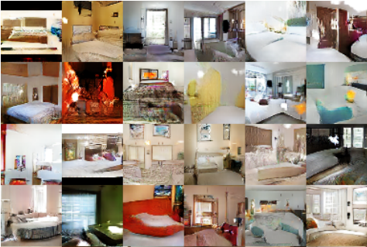
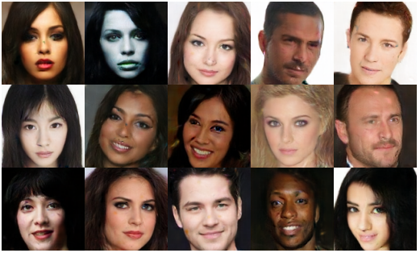
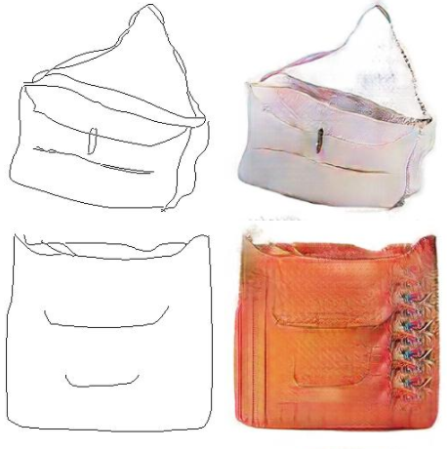
Why Generative Models?
Realistic samples for artwork, super-resolution, colorization, etc.
Generative models of time-series data can be used for simulation and planning (reinforcement learning applications!)
Training generative models can also enable inference of latent representations that can be useful as general features
FIgures from L-R are copyright: (1) Alec Radford et al. 2016; (2) David Berthelot et al. 2017; Phillip Isola et al. 2017. Reproduced with authors permission.
Slide Credit: Fei-Fei Li, Justin Johnson, Serena Yeung, CS 231n

Slide 20
PixelRNN and PixelCNN

Slide 21
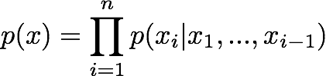
Fully Observable Model
Explicit density model
Use chain rule to decompose likelihood of an image x into product of 1-d distributions:
Likelihood of image x
Probability of i’th pixel value given all previous pixels
Then maximize likelihood of training data
Slide Credit: Fei-Fei Li, Justin Johnson, Serena Yeung, CS 231n
Notes:
Pielrnn and cnn type of fully visible belief network

Slide 22
Fully Observable Model
Explicit density model
Use chain rule to decompose likelihood of an image x into product of 1-d distributions:
Likelihood of image x
Probability of i’th pixel value given all previous pixels
Then maximize likelihood of training data
Complex distribution over pixel values => Express using a neural network!
Slide Credit: Fei-Fei Li, Justin Johnson, Serena Yeung, CS 231n

Slide 23
Fully Observable Model
Explicit density model
Use chain rule to decompose likelihood of an image x into product of 1-d distributions:
Will need to define ordering of “previous pixels”
Likelihood of image x
Probability of i’th pixel value given all previous pixels
Then maximize likelihood of training data
Complex distribution over pixel values => Express using a neural network!
Slide Credit: Fei-Fei Li, Justin Johnson, Serena Yeung, CS 231n

Slide 24
PixelRNN [van der Oord et al. 2016]
Generate image pixels starting from corner
Dependency on previous pixels modeled using an RNN (LSTM)
Slide Credit: Fei-Fei Li, Justin Johnson, Serena Yeung, CS 231n

Slide 25
PixelRNN [van der Oord et al. 2016]
Generate image pixels starting from corner
Dependency on previous pixels modeled using an RNN (LSTM)
Slide Credit: Fei-Fei Li, Justin Johnson, Serena Yeung, CS 231n

Slide 26
PixelRNN [van der Oord et al. 2016]
Generate image pixels starting from corner
Dependency on previous pixels modeled using an RNN (LSTM)
Slide Credit: Fei-Fei Li, Justin Johnson, Serena Yeung, CS 231n

Slide 27
PixelRNN [van der Oord et al. 2016]
Generate image pixels starting from corner
Dependency on previous pixels modeled using an RNN (LSTM)
Drawback: sequential generation is slow!
Slide Credit: Fei-Fei Li, Justin Johnson, Serena Yeung, CS 231n

Slide 28
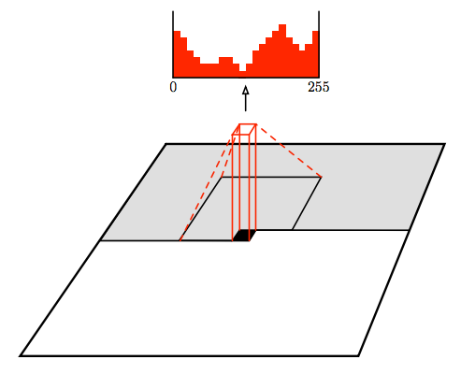
PixelCNN [van der Oord et al. 2016]
Still generate image pixels starting from corner
Dependency on previous pixels now modeled using a CNN over context region
Figure copyright van der Oord et al., 2016. Reproduced with permission.
Slide Credit: Fei-Fei Li, Justin Johnson, Serena Yeung, CS 231n
Notes:
Improves in efficiency over pixelrnn

Slide 29
PixelCNN [van der Oord et al. 2016]
Softmax loss at each pixel
Still generate image pixels starting from corner
Dependency on previous pixels now modeled using a CNN over context region
Training: maximize likelihood of training images
Figure copyright van der Oord et al., 2016. Reproduced with permission.
Slide Credit: Fei-Fei Li, Justin Johnson, Serena Yeung, CS 231n

Slide 30
PixelCNN [van der Oord et al. 2016]
Still generate image pixels starting from corner
Dependency on previous pixels now modeled using a CNN over context region
Training is faster than PixelRNN
(can parallelize convolutions since context region values known from training images)
Generation must still proceed sequentially
=> still slow
Figure copyright van der Oord et al., 2016. Reproduced with permission.
Slide Credit: Fei-Fei Li, Justin Johnson, Serena Yeung, CS 231n

Slide 31
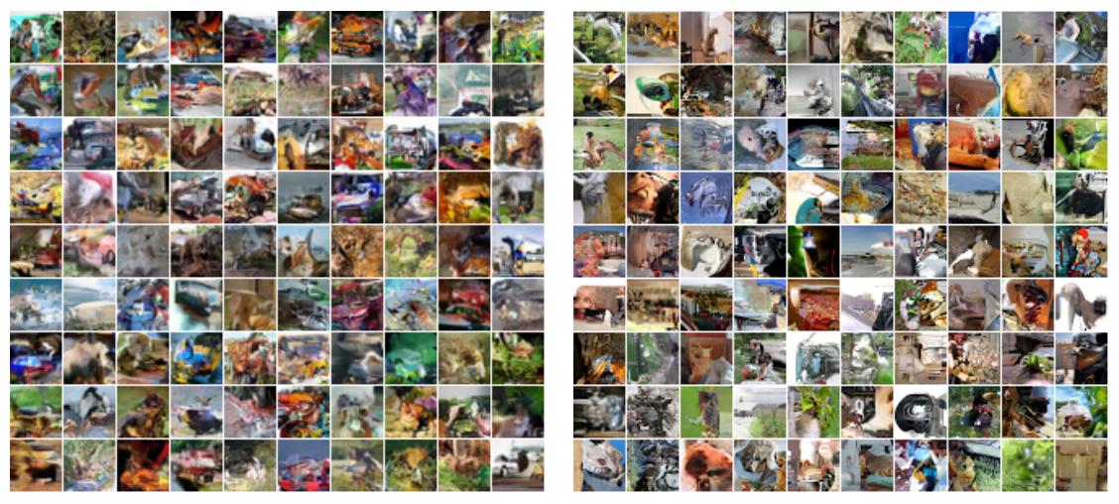
Generation Samples
32x32 CIFAR-10
32x32 ImageNet
Figures copyright Aaron van der Oord et al., 2016. Reproduced with permission.
Slide Credit: Fei-Fei Li, Justin Johnson, Serena Yeung, CS 231n

Slide 32
PixelRNN and PixelCNN
Pros:
Can explicitly compute likelihood p(x)
Explicit likelihood of training data gives good evaluation metric
Good samples
Con:
Sequential generation => slow
Improving PixelCNN performance
Gated convolutional layers
Short-cut connections
Discretized logistic loss
Multi-scale
Training tricks
Etc…
See
Van der Oord et al. NIPS 2016
Salimans et al. 2017 (PixelCNN++)
Slide Credit: Fei-Fei Li, Justin Johnson, Serena Yeung, CS 231n
Notes:
When is it not computationally tractable?

Slide 33
Variational Autoencoders (VAE)

Slide 34
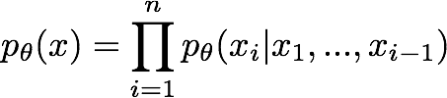
So far...
PixelCNNs define tractable density function, optimize likelihood of training data:
Slide Credit: Fei-Fei Li, Justin Johnson, Serena Yeung, CS 231n

Slide 35
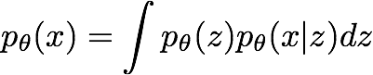
So far...
PixelCNNs define tractable density function, optimize likelihood of training data:
VAEs define intractable density function with latent z:
Cannot optimize directly, derive and optimize lower bound on likelihood instead
Slide Credit: Fei-Fei Li, Justin Johnson, Serena Yeung, CS 231n

Slide 36
Variational Auto Encoders
VAEs are a combination of the following ideas:
Auto Encoders
Variational Approximation
Variational Lower Bound / ELBO
Amortized Inference Neural Networks
“Reparameterization” Trick

Slide 37
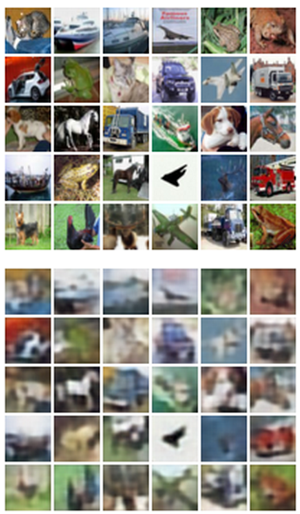
Autoencoders
Unsupervised approach for learning a lower-dimensional feature representation from unlabeled training data
Features
Encoder
Input data
Slide Credit: Fei-Fei Li, Justin Johnson, Serena Yeung, CS 231n
Notes:
Generative model with latent variables to maximize training data
What is unsupervised learning? Learning feature representations with unsupervised objectives, vs. learning generative models for data, etc…
Explicit density estimation (PixelCNN) vs. Autoencoder vs. VAE vs. GANs. Compare and contrast. In particular, VAE vs. GAN. What are advantages of VAE? Are Autoencoders still used? In what context? Or why not?
What is current research, pros / cons of each?

Slide 38
Autoencoders
Unsupervised approach for learning a lower-dimensional feature representation from unlabeled training data
Originally: Linear + nonlinearity (sigmoid)
Later: Deep, fully-connected
Later: ReLU CNN
Features
Encoder
Input data
Slide Credit: Fei-Fei Li, Justin Johnson, Serena Yeung, CS 231n

Slide 39
Autoencoders
Unsupervised approach for learning a lower-dimensional feature representation from unlabeled training data
z usually smaller than x
(dimensionality reduction)
Originally: Linear + nonlinearity (sigmoid)
Later: Deep, fully-connected
Later: ReLU CNN
Q: Why dimensionality reduction?
Features
Encoder
Input data
Slide Credit: Fei-Fei Li, Justin Johnson, Serena Yeung, CS 231n

Slide 40
Autoencoders
Unsupervised approach for learning a lower-dimensional feature representation from unlabeled training data
z usually smaller than x
(dimensionality reduction)
Originally: Linear + nonlinearity (sigmoid)
Later: Deep, fully-connected
Later: ReLU CNN
Q: Why dimensionality reduction?
A: Want features to capture meaningful factors of variation in data
Features
Encoder
Input data
Slide Credit: Fei-Fei Li, Justin Johnson, Serena Yeung, CS 231n

Slide 41
Autoencoders
How to learn this feature representation?
Features
Encoder
Input data
Slide Credit: Fei-Fei Li, Justin Johnson, Serena Yeung, CS 231n

Slide 42
Autoencoders
How to learn this feature representation?
Train such that features can be used to reconstruct original data
“Autoencoding” - encoding itself
Reconstructed input data
Decoder
Features
Encoder
Input data
Slide Credit: Fei-Fei Li, Justin Johnson, Serena Yeung, CS 231n

Slide 43
Autoencoders
How to learn this feature representation?
Train such that features can be used to reconstruct original data
“Autoencoding” - encoding itself
Originally: Linear + nonlinearity (sigmoid)
Later: Deep, fully-connected
Later: ReLU CNN (upconv)
Reconstructed input data
Decoder
Features
Encoder
Input data
Slide Credit: Fei-Fei Li, Justin Johnson, Serena Yeung, CS 231n

Slide 44
Autoencoders
Reconstructed data
How to learn this feature representation?
Train such that features can be used to reconstruct original data
“Autoencoding” - encoding itself
Reconstructed input data
Encoder: 4-layer conv
Decoder: 4-layer upconv
Decoder
Input data
Features
Encoder
Input data
Slide Credit: Fei-Fei Li, Justin Johnson, Serena Yeung, CS 231n

Slide 45
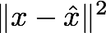
Autoencoders
Reconstructed data
Train such that features can be used to reconstruct original data
L2 Loss function:
Reconstructed input data
Encoder: 4-layer conv
Decoder: 4-layer upconv
Decoder
Input data
Features
Encoder
Input data
Slide Credit: Fei-Fei Li, Justin Johnson, Serena Yeung, CS 231n

Slide 46
Autoencoders
Reconstructed data
Train such that features can be used to reconstruct original data
Doesn’t use labels!
L2 Loss function:
Reconstructed input data
Encoder: 4-layer conv
Decoder: 4-layer upconv
Decoder
Input data
Features
Encoder
Input data
Slide Credit: Fei-Fei Li, Justin Johnson, Serena Yeung, CS 231n

Slide 47
Autoencoders
Reconstructed input data
Decoder
Features
After training,
throw away decoder
Encoder
Input data
Slide Credit: Fei-Fei Li, Justin Johnson, Serena Yeung, CS 231n

Slide 48
Autoencoders
Loss function (Softmax, etc)
bird
plane
dog
deer
truck
Predicted Label
Train for final task (sometimes with small data)
Classifier
Fine-tune encoder jointly with classifier
Encoder can be used to initialize a supervised model
Features
Encoder
Input data
Slide Credit: Fei-Fei Li, Justin Johnson, Serena Yeung, CS 231n

Slide 49
Autoencoders
Autoencoders can reconstruct data, and can learn features to initialize a supervised model
Features capture factors of variation in training data. Can we generate new images from an autoencoder?
Reconstructed input data
Decoder
Features
Encoder
Input data
Slide Credit: Fei-Fei Li, Justin Johnson, Serena Yeung, CS 231n

Slide 50
Variational Autoencoders
Probabilistic spin on autoencoders - will let us sample from the model to generate data!
Slide Credit: Fei-Fei Li, Justin Johnson, Serena Yeung, CS 231n

Slide 51
Variational Auto Encoders
VAEs are a combination of the following ideas:
Auto Encoders
Variational Approximation
Variational Lower Bound / ELBO
Amortized Inference Neural Networks
“Reparameterization” Trick

Slide 52
Basic Problem
Goal
Need to compute:

Slide 53
Example

Slide 54
Example

Slide 55
Two Options
Score Function based Gradient Estimator aka REINFORCE (and variants)
Path Derivative Gradient Estimator aka “reparameterization trick”

Slide 56
Option 1
Score Function based Gradient Estimator aka REINFORCE (and variants)

Slide 57
Example

Slide 58
Two Options
Score Function based Gradient Estimator aka REINFORCE (and variants)
Path Derivative Gradient Estimator aka “reparameterization trick”

Slide 59
Option 2
Path Derivative Gradient Estimator aka “reparameterization trick”

Slide 60
Example

Slide 61
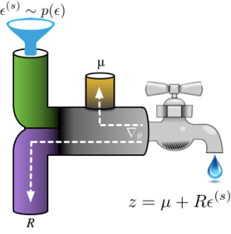
Reparameterization Intuition
Figure Credit: http://blog.shakirm.com/2015/10/machine-learning-trick-of-the-day-4-reparameterisation-tricks/

Slide 62
Two Options
Score Function based Gradient Estimator aka REINFORCE (and variants)
Path Derivative Gradient Estimator aka “reparameterization trick”

Slide 63
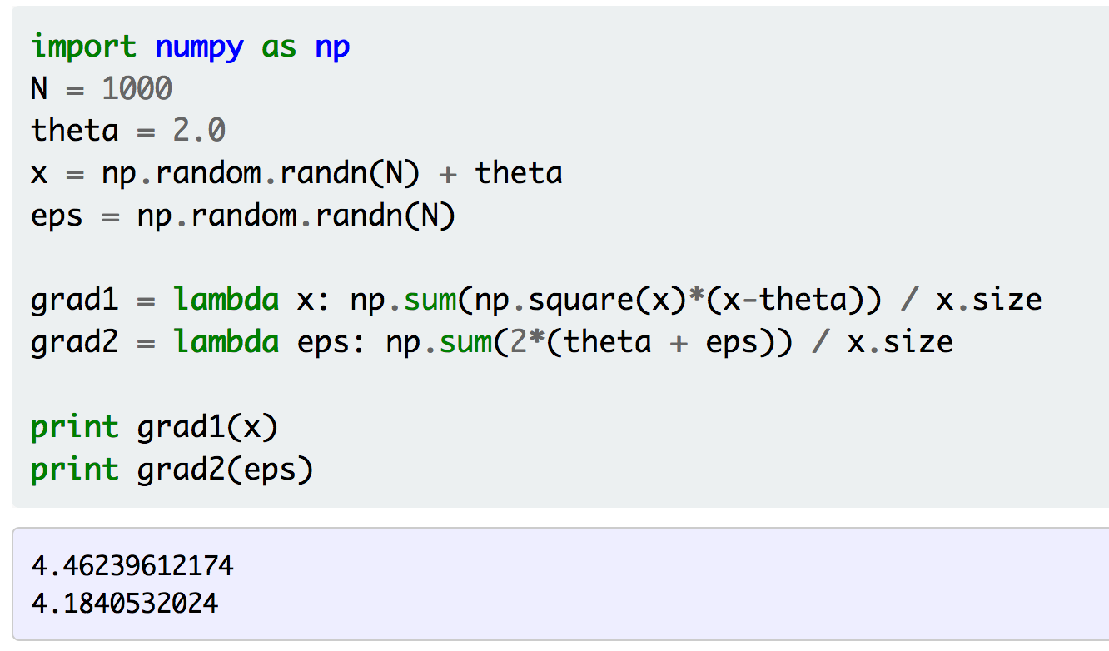
Example
Figure Credit: http://gokererdogan.github.io/2016/07/01/reparameterization-trick/

Slide 64
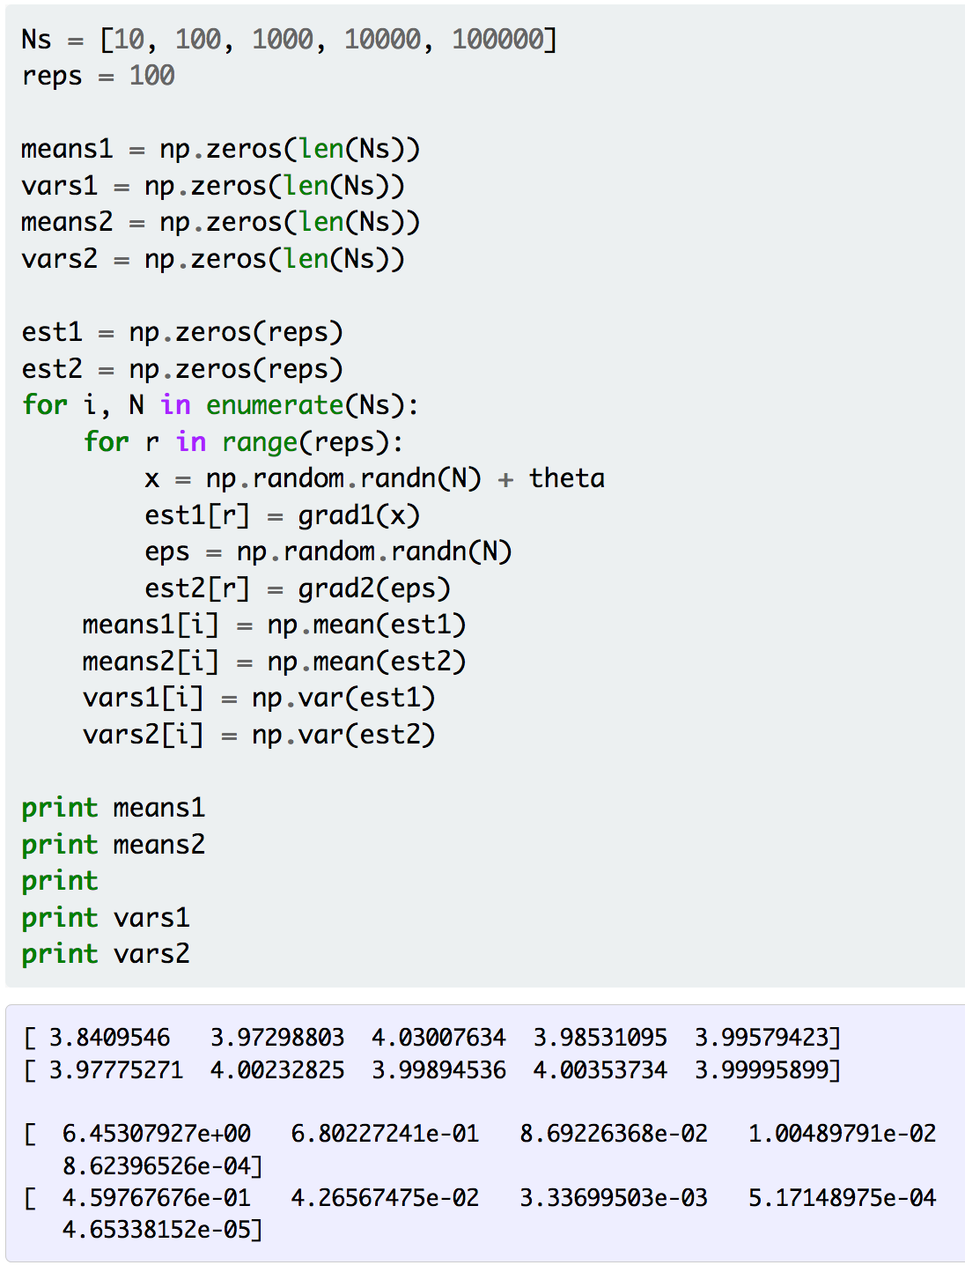
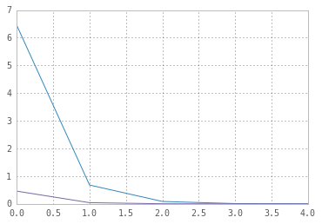
Example
Figure Credit: http://gokererdogan.github.io/2016/07/01/reparameterization-trick/

Slide 65
Aside: Gumbel Softmax
Meet the Gumbel Softmax “trick”

Slide 66
Aside: Gumbel Softmax
Sampling on the Simplex

Slide 67
Variational Auto Encoders
VAEs are a combination of the following ideas:
Auto Encoders
Variational Approximation
Variational Lower Bound / ELBO
Amortized Inference Neural Networks
“Reparameterization” Trick

Slide 68
What is Variational Inference?
A class of methods for
approximate inference, parameter learning
And approximating integrals basically..
Key idea
Reality is complex
Instead of performing approximate computation in something complex,
Can we perform exact computation in something “simple”?
Just need to make sure the simple thing is “close” to the complex thing.

Slide 69
Intuition

Slide 70
KL divergence: Distance between distributions
Given two distributions p and q KL divergence:
D(p||q) = 0 iff p=q
Not symmetric – p determines where difference is important
Slide Credit: Carlos Guestrin

Slide 71
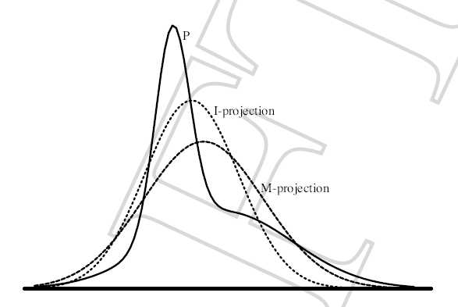
Find simple approximate distribution
Suppose p is intractable posterior
Want to find simple q that approximates p
KL divergence not symmetric
D(p||q)
true distribution p defines support of diff.
the “correct” direction
will be intractable to compute
D(q||p)
approximate distribution defines support
tends to give overconfident results
will be tractable
Slide Credit: Carlos Guestrin

Slide 72
Example 1
p = 2D Gaussian with arbitrary co-variance
q = 2D Gaussian with diagonal co-variance
argmin_q KL (p || q)
argmin_q KL (q || p)
p = Green; q = Red

Slide 73
Example 2
p = Mixture of Two Gaussians
q = Single Gaussian
argmin_q KL (p || q)
argmin_q KL (q || p)
p = Blue; q = Red

Slide 74
The general learning problem with missing data
Marginal likelihood – x is observed, z is missing:

Slide 75
Applying Jensen’s inequality
Use: log ∑_{z} P(z) f(z) ≥ ∑_{z} P(z) log f(z)

Slide 76
Applying Jensen’s inequality
Use: log ∑_{z} P(z) f(z) ≥ ∑_{z} P(z) log f(z)

Slide 77
Evidence Based Lower Bound
Define potential function F(θ,Q):

Slide 78
Evidence Based Lower Bound
Define potential function F(θ,Q):
EM corresponds to coordinate ascent on F
Thus, maximizes lower bound on marginal log likelihood

Slide 79
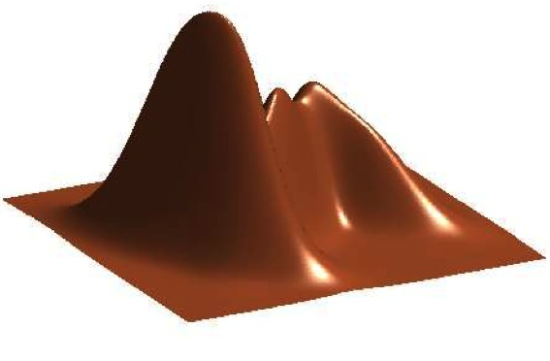
GMM
Figure Credit: Kevin Murphy

Slide 81
EM for Learning GMMs
Simple Update Rules
E-Step: estimate Q_{i}(z) = Pr(z = j | x_{i})
M-Step: maximize full likelihood weighted by posterior

Slide 82
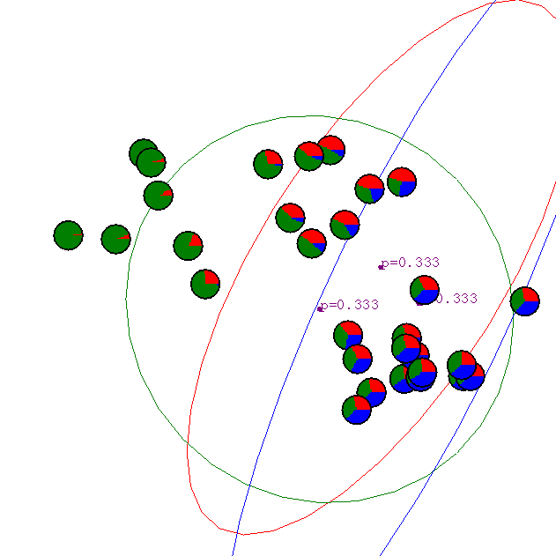
Gaussian Mixture Example: Start
Slide Credit: Carlos Guestrin

Slide 83
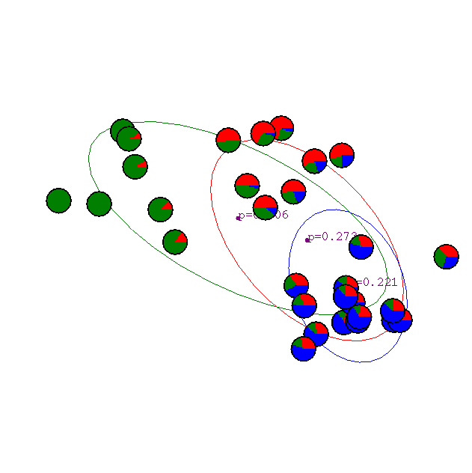
After 1st iteration
Slide Credit: Carlos Guestrin

Slide 84

After 2nd iteration
Slide Credit: Carlos Guestrin

Slide 85

After 3rd iteration
Slide Credit: Carlos Guestrin

Slide 86

After 4th iteration
Slide Credit: Carlos Guestrin

Slide 87

After 5th iteration
Slide Credit: Carlos Guestrin

Slide 88

After 6th iteration
Slide Credit: Carlos Guestrin

Slide 89

After 20th iteration
Slide Credit: Carlos Guestrin

Slide 90
Variational Auto Encoders
VAEs are a combination of the following ideas:
Auto Encoders
Variational Approximation
Variational Lower Bound / ELBO
Amortized Inference Neural Networks
“Reparameterization” Trick

Slide 91
Amortized Inference Neural Networks

Slide 92
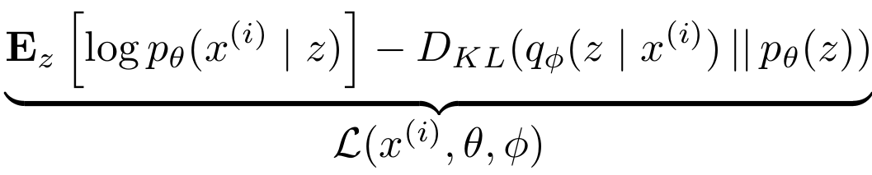
Variational Auto Encoders
Putting it all together: maximizing the likelihood lower bound

Slide 93
Variational Auto Encoders
Putting it all together: maximizing the likelihood lower bound
Let’s look at computing the bound (forward pass) for a given minibatch of input data
Input Data

Slide 94
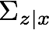
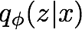
Variational Auto Encoders
Putting it all together: maximizing the likelihood lower bound
Encoder network
Input Data

Slide 95
Variational Auto Encoders
Putting it all together: maximizing the likelihood lower bound
Make approximate posterior distribution close to prior
Encoder network
Input Data

Slide 96
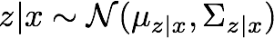
Variational Auto Encoders
Putting it all together: maximizing the likelihood lower bound
Sample z from
Make approximate posterior distribution close to prior
Encoder network
Input Data

Slide 97
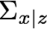
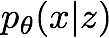
Variational Auto Encoders
Putting it all together: maximizing the likelihood lower bound
Decoder network
Sample z from
Make approximate posterior distribution close to prior
Encoder network
Input Data

Slide 98
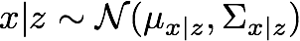
Variational Auto Encoders
Putting it all together: maximizing the likelihood lower bound
Maximize likelihood of original input being reconstructed
Sample x|z from
Decoder network
Sample z from
Make approximate posterior distribution close to prior
Encoder network
Input Data

Slide 99
Variational Auto Encoders
Putting it all together: maximizing the likelihood lower bound
Maximize likelihood of original input being reconstructed
Sample x|z from
Decoder network
Sample z from
Make approximate posterior distribution close to prior
Encoder network
For every minibatch of input data: compute this forward pass, and then backprop!
Input Data

Slide 100
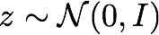
Variational Auto Encoders: Generating Data
Use decoder network. Now sample z from prior!
Sample x|z from
Decoder network
Sample z from
Kingma and Welling, “Auto-Encoding Variational Bayes”, ICLR 2014

Slide 101
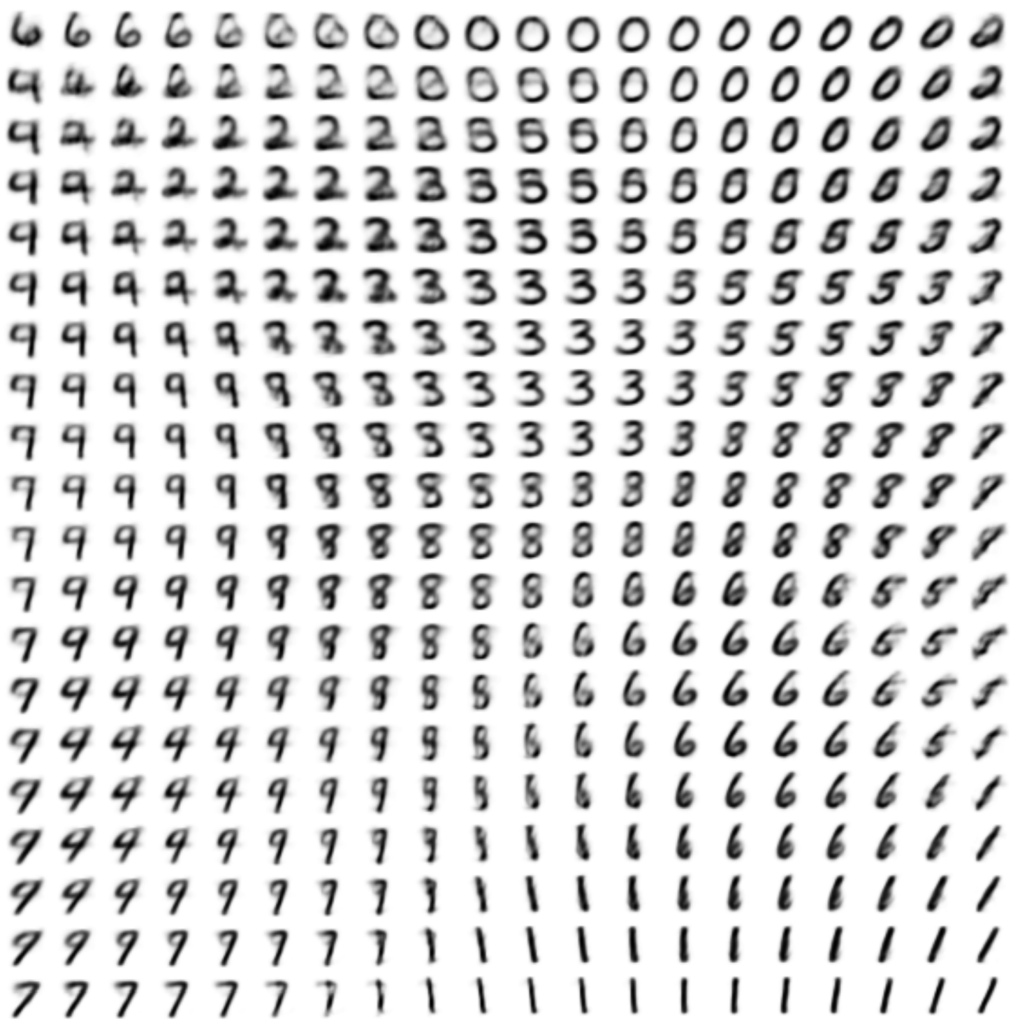
Variational Auto Encoders: Generating Data
Use decoder network. Now sample z from prior!
Sample x|z from
Decoder network
Sample z from
Kingma and Welling, “Auto-Encoding Variational Bayes”, ICLR 2014

Slide 102
Variational Auto Encoders: Generating Data
Use decoder network. Now sample z from prior!
Data manifold for 2-d z
Sample x|z from
Vary z₁
Decoder network
Sample z from
Kingma and Welling, “Auto-Encoding Variational Bayes”, ICLR 2014
Vary z₂

Slide 103
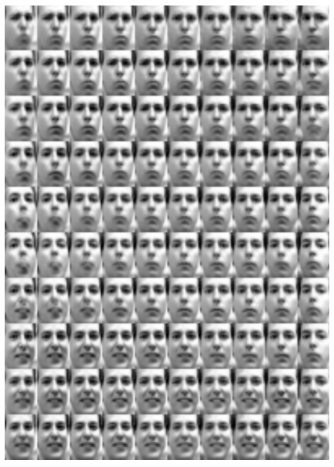
Variational Auto Encoders: Generating Data
Diagonal prior on z => independent latent variables
Different dimensions of z encode interpretable factors of variation
Degree of smile
Vary z₁
Vary z₂
Head pose
Kingma and Welling, “Auto-Encoding Variational Bayes”, ICLR 2014

Slide 104
Variational Auto Encoders: Generating Data
Diagonal prior on z => independent latent variables
Different dimensions of z encode interpretable factors of variation
Degree of smile
Vary z₁
Also good feature representation that can be computed using q_{ɸ}(z|x)!
Vary z₂
Head pose
Kingma and Welling, “Auto-Encoding Variational Bayes”, ICLR 2014

Slide 105
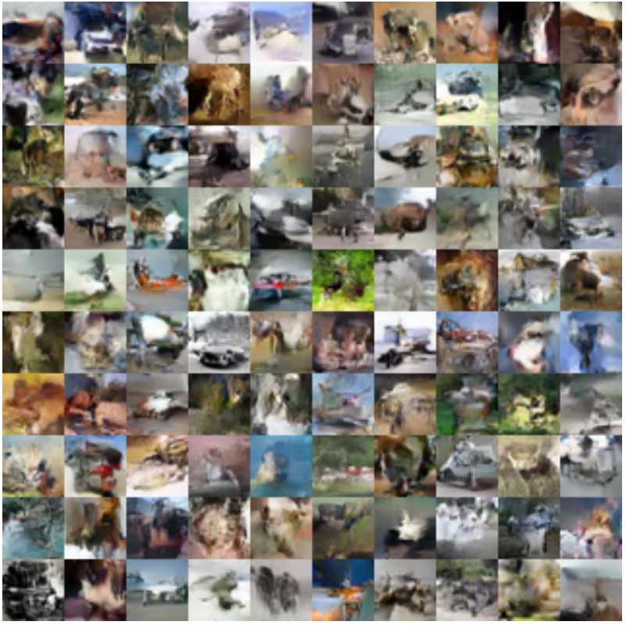
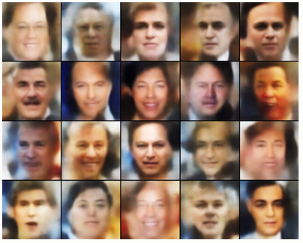
Variational Auto Encoders: Generating Data
Labeled Faces in the Wild
32x32 CIFAR-10
Figures copyright (L) Dirk Kingma et al. 2016; (R) Anders Larsen et al. 2017. Reproduced with permission.

Slide 106
Variational Autoencoders
Probabilistic spin to traditional autoencoders => allows generating data
Defines an intractable density => derive and optimize a (variational) lower bound
Pros:
Principled approach to generative models
Allows inference of q(z|x), can be useful feature representation for other tasks
Cons:
Maximizes lower bound of likelihood: okay, but not as good evaluation as PixelRNN/PixelCNN
Samples blurrier and lower quality compared to state-of-the-art (GANs)
Active areas of research:
More flexible approximations, e.g. richer approximate posterior instead of diagonal Gaussian
Incorporating structure in latent variables

Slide 107
Generative Adversarial Networks (GAN)

Slide 108
So far...
PixelCNNs define tractable density function, optimize likelihood of training data:
VAEs define intractable density function with latent z:
Cannot optimize directly, derive and optimize lower bound on likelihood instead

Slide 109
So far...
PixelCNNs define tractable density function, optimize likelihood of training data:
VAEs define intractable density function with latent z:
Cannot optimize directly, derive and optimize lower bound on likelihood instead
What if we give up on explicitly modeling density, and just want ability to sample?

Slide 110
So far...
PixelCNNs define tractable density function, optimize likelihood of training data:
VAEs define intractable density function with latent z:
Cannot optimize directly, derive and optimize lower bound on likelihood instead
What if we give up on explicitly modeling density, and just want ability to sample?
GANs: don’t work with any explicit density function!

Slide 111
Generative Adversarial Networks
Ian Goodfellow et al., “Generative Adversarial Nets”, NIPS 2014
Problem: Want to sample from complex, high-dimensional training distribution. No direct way to do this!
Solution: Sample from a simple distribution, e.g. random noise. Learn transformation to training distribution.
Q: What can we use to represent this complex transformation?
Notes:
Mapping z to data manifold?
Hard to sample from high dimensional distribution. Take random noise, transform to real distribution

Slide 112
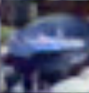
Generative Adversarial Networks
Ian Goodfellow et al., “Generative Adversarial Nets”, NIPS 2014
Problem: Want to sample from complex, high-dimensional training distribution. No direct way to do this!
Solution: Sample from a simple distribution, e.g. random noise. Learn transformation to training distribution.
Q: What can we use to represent this complex transformation?
Output: Sample from training distribution
A: A neural network!
Generator Network
Input: Random noise
z
Notes:
Mapping z to data manifold?
Hard to sample from high dimensional distribution. Take random noise, transform to real distribution

Slide 113
Training GANs: Two-player game
Ian Goodfellow et al., “Generative Adversarial Nets”, NIPS 2014
Generator network: try to fool the discriminator by generating real-looking images
Discriminator network: try to distinguish between real and fake images
Notes:
Mapping z to data manifold?

Slide 114
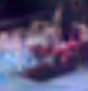
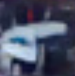
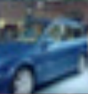
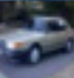
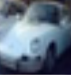
Training GANs: Two-player game
Ian Goodfellow et al., “Generative Adversarial Nets”, NIPS 2014
Generator network: try to fool the discriminator by generating real-looking images
Discriminator network: try to distinguish between real and fake images
Real or Fake
Discriminator Network
Fake Images
(from generator)
Real Images
(from training set)
Generator Network
Random noise
z
Fake and real images copyright Emily Denton et al. 2015. Reproduced with permission.
Notes:
Mapping z to data manifold?

Slide 115
Training GANs: Two-player game
Ian Goodfellow et al., “Generative Adversarial Nets”, NIPS 2014
Generator network: try to fool the discriminator by generating real-looking images
Discriminator network: try to distinguish between real and fake images
Train jointly in minimax game
Minimax objective function:
Notes:
Mapping z to data manifold?

Slide 116
Training GANs: Two-player game
Ian Goodfellow et al., “Generative Adversarial Nets”, NIPS 2014
Generator network: try to fool the discriminator by generating real-looking images
Discriminator network: try to distinguish between real and fake images
Train jointly in minimax game
Minimax objective function:
Discriminator outputs likelihood in (0,1) of real image
Discriminator output for real data x
Discriminator output for generated fake data G(z)
Notes:
Mapping z to data manifold?

Slide 117
Training GANs: Two-player game
Ian Goodfellow et al., “Generative Adversarial Nets”, NIPS 2014
Generator network: try to fool the discriminator by generating real-looking images
Discriminator network: try to distinguish between real and fake images
Train jointly in minimax game
Minimax objective function:
Discriminator outputs likelihood in (0,1) of real image
Discriminator output for real data x
Discriminator output for generated fake data G(z)
Discriminator (θ_{d}) wants to maximize objective such that D(x) is close to 1 (real) and D(G(z)) is close to 0 (fake)
Generator (θ_{g}) wants to minimize objective such that D(G(z)) is close to 1 (discriminator is fooled into thinking generated G(z) is real)
Notes:
Mapping z to data manifold?

Slide 118
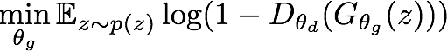
Training GANs: Two-player game
Ian Goodfellow et al., “Generative Adversarial Nets”, NIPS 2014
Minimax objective function:
Alternate between:
Gradient ascent on discriminator
2. Gradient descent on generator
Notes:
Mapping z to data manifold?

Slide 119

Training GANs: Two-player game
Ian Goodfellow et al., “Generative Adversarial Nets”, NIPS 2014
Minimax objective function:
Gradient signal dominated by region where sample is already good
Alternate between:
Gradient ascent on discriminator
2. Gradient descent on generator
When sample is likely fake, want to learn from it to improve generator. But gradient in this region is relatively flat!
In practice, optimizing this generator objective does not work well!
Notes:
Mapping z to data manifold?

Slide 120


Training GANs: Two-player game
Ian Goodfellow et al., “Generative Adversarial Nets”, NIPS 2014
Minimax objective function:
Alternate between:
Gradient ascent on discriminator
2. Instead: Gradient ascent on generator, different objective
Instead of minimizing likelihood of discriminator being correct, now maximize likelihood of discriminator being wrong.
Same objective of fooling discriminator, but now higher gradient signal for bad samples => works much better! Standard in practice.
High gradient signal
Low gradient signal
Notes:
Mapping z to data manifold?

Slide 121
Training GANs: Two-player game
Ian Goodfellow et al., “Generative Adversarial Nets”, NIPS 2014
Minimax objective function:
Aside: Jointly training two networks is challenging, can be unstable. Choosing objectives with better loss landscapes helps training, is an active area of research.
Alternate between:
Gradient ascent on discriminator
2. Instead: Gradient ascent on generator, different objective
Instead of minimizing likelihood of discriminator being correct, now maximize likelihood of discriminator being wrong.
Same objective of fooling discriminator, but now higher gradient signal for bad samples => works much better! Standard in practice.
High gradient signal
Low gradient signal
Notes:
Mapping z to data manifold?

